Slide 1

Geometry
Unit 11, Lesson 4 Solving Problems Involving Quadrilaterals Inscribed in Circles Volume 2, pg. 197

Slide 2


Benchmark
MA.912.GR.6.3
Solve mathematical problems involving triangles and quadrilaterals inscribed in a circle.
volume 2, pg. 197

Slide 3
Integrated Mathematical Thinking and Reasoning Standards
MA.K12.MTR.1.1 Actively participate in effortful learning both individually and collectively.
MA.K12.MTR.2.1 Demonstrate understanding by representing problems in multiple ways.
MA.K12.MTR.4.1 Engage in discussions that reflect on the mathematical thinking of self and others.
MA.K12.MTR.5.1 Use patterns and structure to help understand and connect mathematical concepts.
MA.K12.MTR.6.1 Assess the reasonableness of solutions.
volume 2, pg. 197

Slide 4

Learning Target
I can solve mathematical problems involving quadrilaterals inscribed in a circle.
volume 2, pg. 197

Slide 5

Warm-Up
volume 2, pg. 197

Slide 6
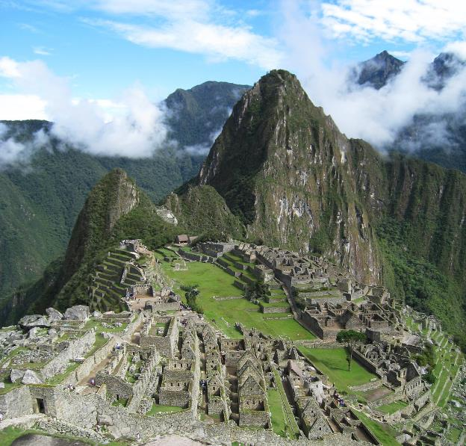
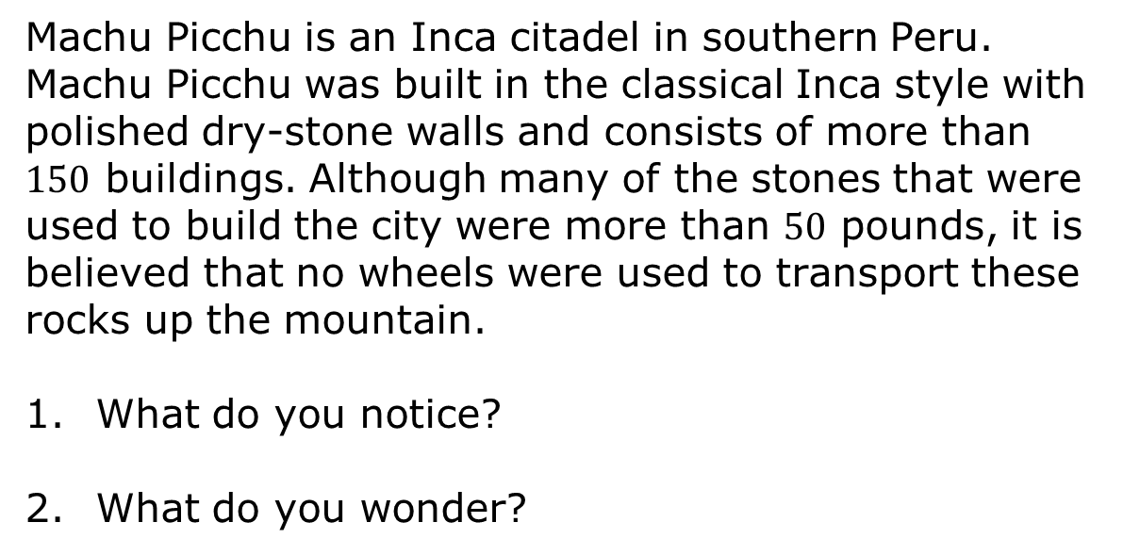
11.4.1 Warm-Up: Notice and Wonder
Machu Picchu is an Inca citadel in southern Peru. Machu Picchu was built in the classical Inca style with polished dry-stone walls and consists of more than $150$ buildings. Although many of the stones that were used to build the city were more than $50$ pounds, it is believed that no wheels were used to transport these rocks up the mountain.
What do you notice?
What do you wonder?
volume 2, pg. 197

Slide 7

Exploration
volume 2, pg. 198

Slide 8

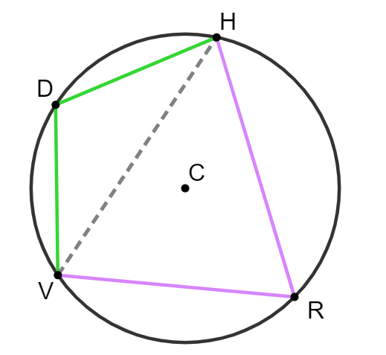
11.4.2 Exploration: Quadrilaterals Inscribed in Circles
Circle $C$ is shown, where $\overline{DV}≅\overline{DH}$. $m\overset{⏜}{RV}=100°$, $m\overset{⏜}{DV}=68°$, $m\overset{⏜}{HDV}=136°$, and $m\overset{⏜}{HRV}=224°$.
volume 2, pg. 198

Slide 9
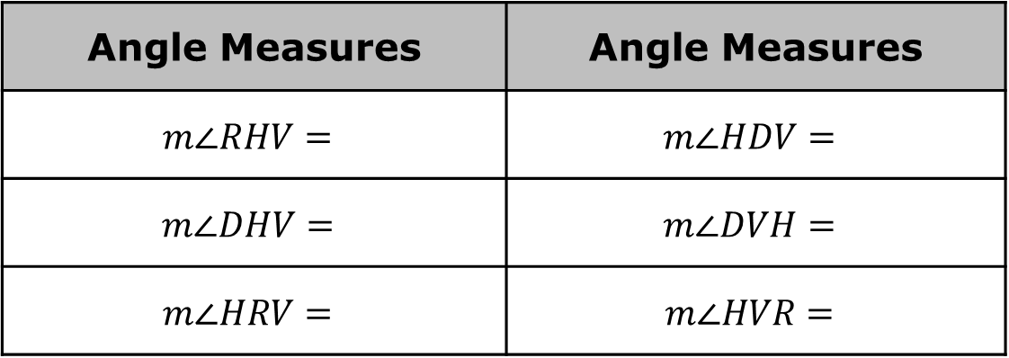

Complete the table.
Work with your partner to make a conjecture about the relationships of the angles in $DHRV$.
Angle Measures | Angle Measures
$$m∠RHV=$$ | $$m∠HDV=$$
$$m∠DHV=$$ | $$m∠DVH=$$
$$m∠HRV=$$ | $$m∠HVR=$$
volume 2, pg. 198

Slide 10
Ask two classmates for their conjectures. Record their conjectures and write your summary of their reason. You are the only person who should write in the first two columns of the table. Have the person initial next to your summary stating that your summary was correct.
Review your conjecture with your partner. If necessary, make any changes.
Conjecture | My Summary of Their Reason | Initials
volume 2, pg. 198

Slide 11
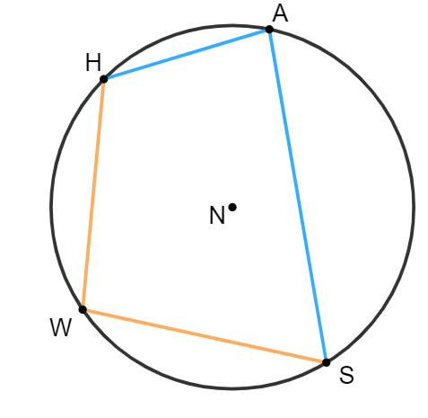
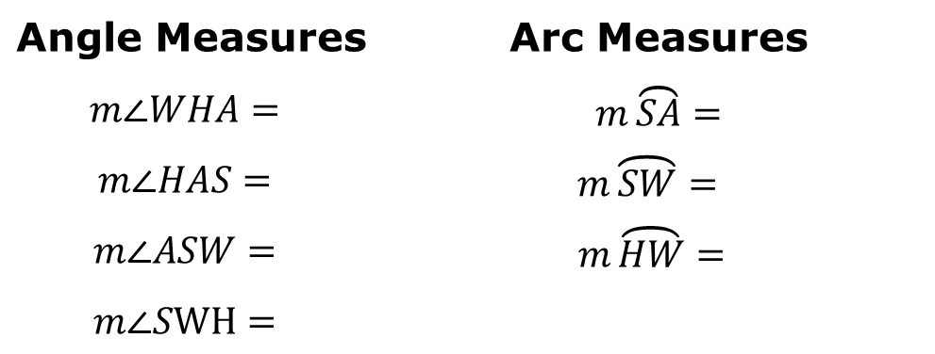

Circle $N$ has points $H$, $A$, $S$, and $W$ on the circle. Quadrilateral $HASW$ is inscribed in the circle. $m\overset{⏜}{HA}=59°, m\overset{⏜}{HWS}=166°$ and $m\overset{⏜}{WHA}=136°$.
Use your conjecture to find the measures.
Angle Measures | Arc Measures
$$m∠WHA=$$ | $m\overset{⏜}{SA}=$
$$m∠HAS=$$ | $$m\overset{⏜}{SW}=$$
$$m∠ASW=$$ | $$m\overset{⏜}{HW}=$$
$$m∠SWH=$$
volume 2, pg. 199

Slide 12

Guided Practice
volume 2, pg. 199

Slide 13

11.4.3 Guided Practice: Quadrilaterals Inscribed in Circles
Complete the statement.
If a quadrilateral is inscribed in a circle, angles are
adjacent
opposite
congruent.
complementary.
supplementary.
volume 2, pg. 199

Slide 14
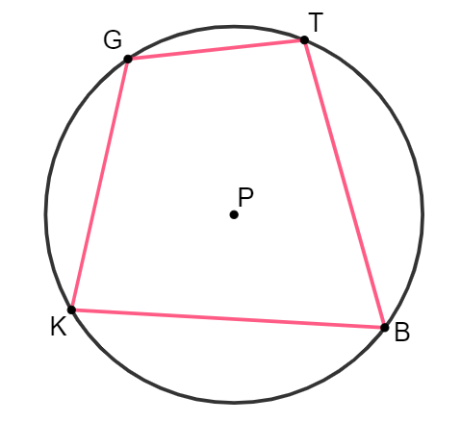
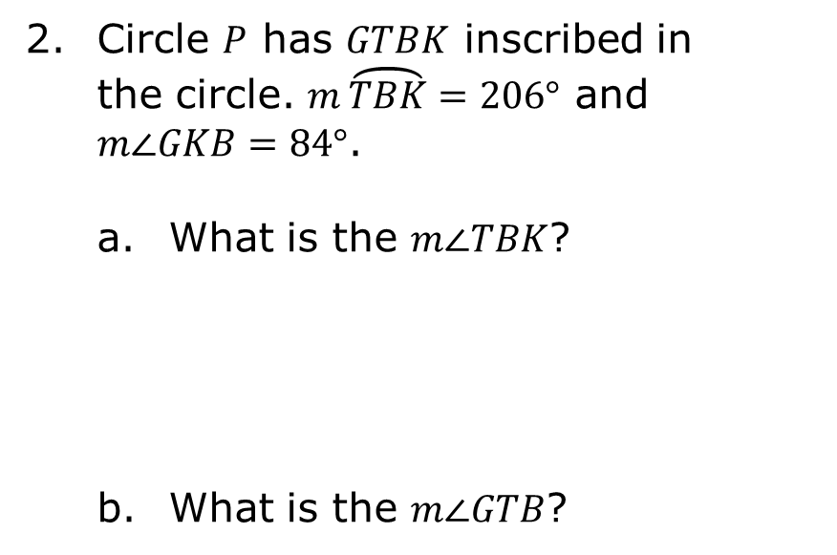
Circle $P$ has $GTBK$ inscribed in the circle. $m\overset{⏜}{TBK}=206°$ and $m∠GKB=84°$.
What is the $m∠TBK$?
What is the $m∠GTB$?
volume 2, pg. 199

Slide 15
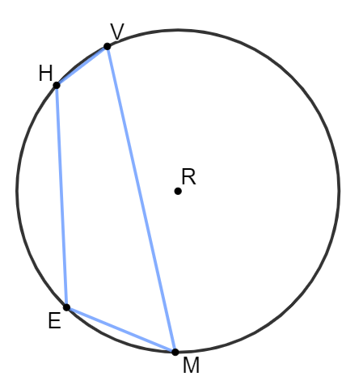
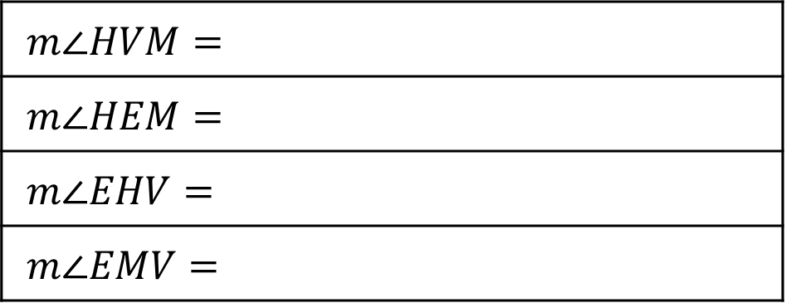
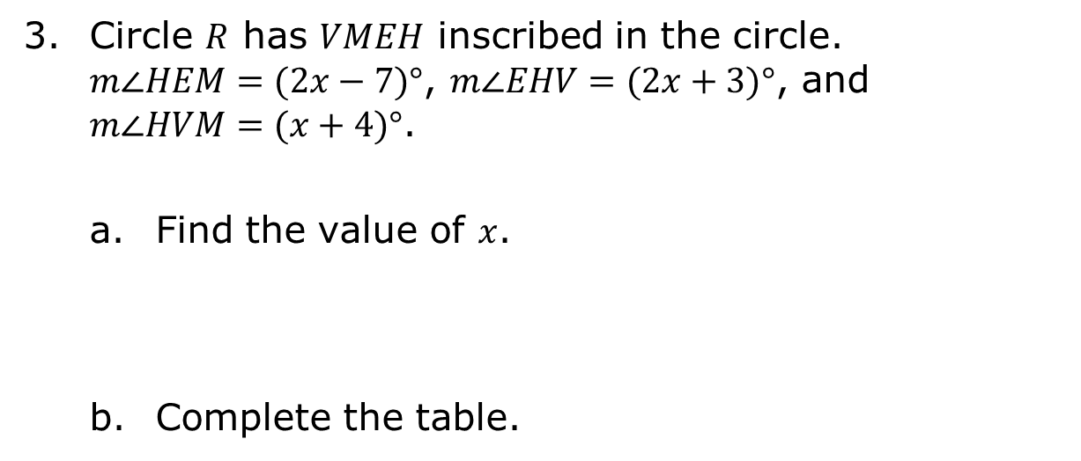
Circle $R$ has $VMEH$ inscribed in the circle. $m∠HEM=(2x−7)°$, $m∠EHV=(2x+3)°$, and $m∠HVM=(x+4)°$.
Find the value of $x$.
Complete the table.
$$m∠HVM=$$
$$m∠HEM=$$
$$m∠EHV=$$
$$m∠EMV=$$
volume 2, pg. 200

Slide 16

Your Turn
volume 2, pg. 200

Slide 17
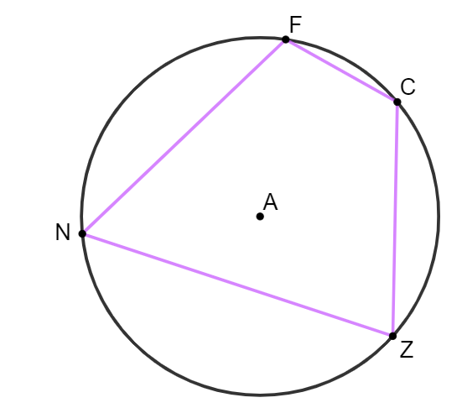
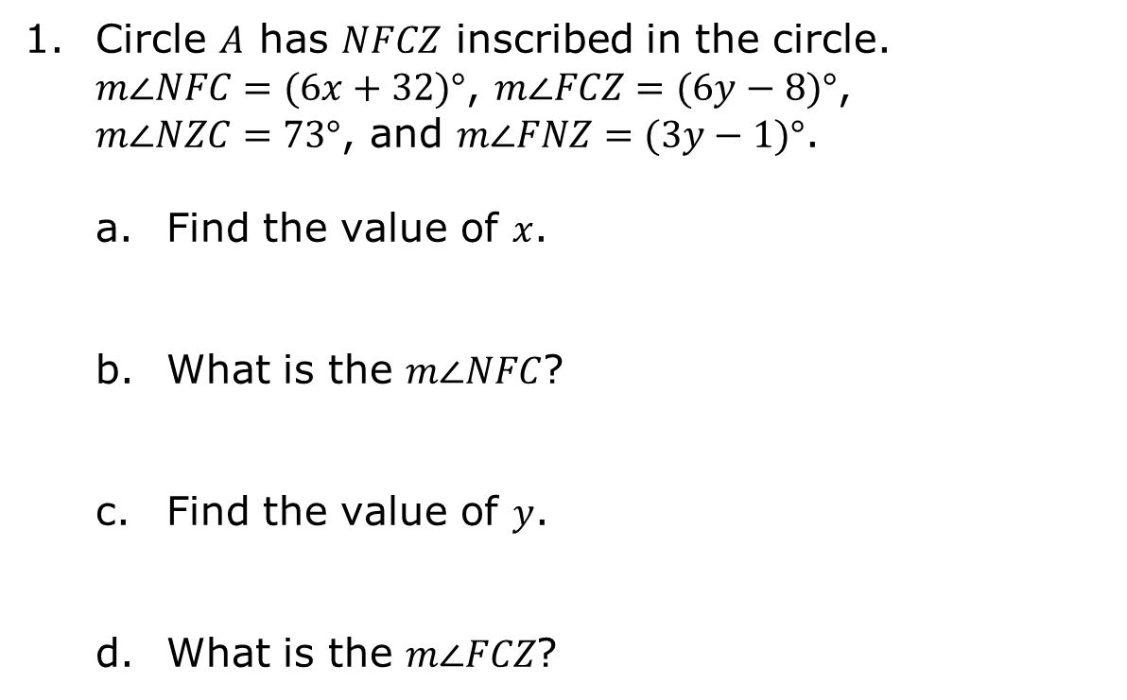
11.4.4 Your Turn!
Circle $A$ has $NFCZ$ inscribed in the circle. $m∠NFC=(6x+32)°$, $m∠FCZ=(6y−8)°$, $m∠NZC=73°$, and $m∠FNZ=(3y−1)°$.
Find the value of $x$.
What is the $m∠NFC$?
Find the value of $y$.
What is the $m∠FCZ$?
volume 2, pg. 200

Slide 18
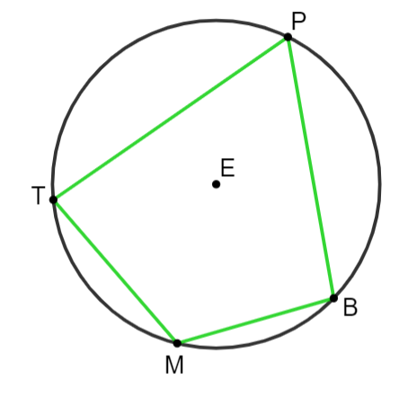
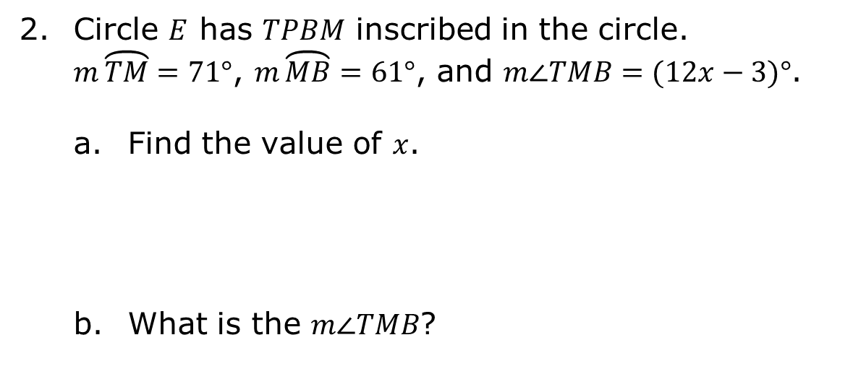
Circle $E$ has $TPBM$ inscribed in the circle. $m\overset{⏜}{TM}=71°$, $m\overset{⏜}{MB}=61°$, and $m∠TMB=(12x−3)°$.
Find the value of $x$.
What is the $m∠TMB$?
volume 2, pg. 201

Slide 19

Wrap-Up
volume 2, pg. 201

Slide 20
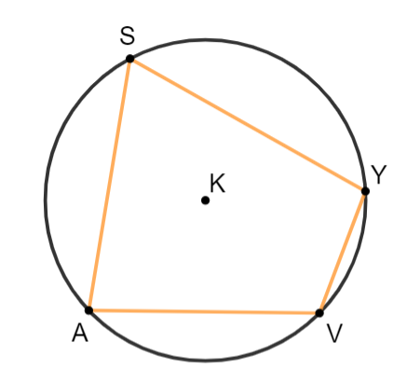
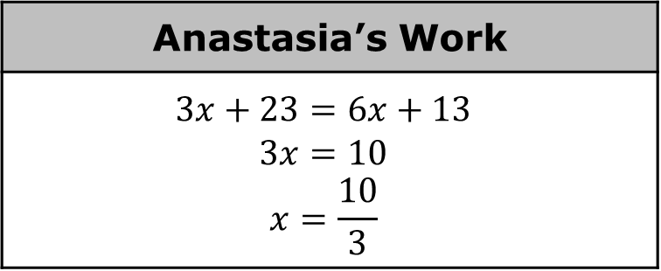
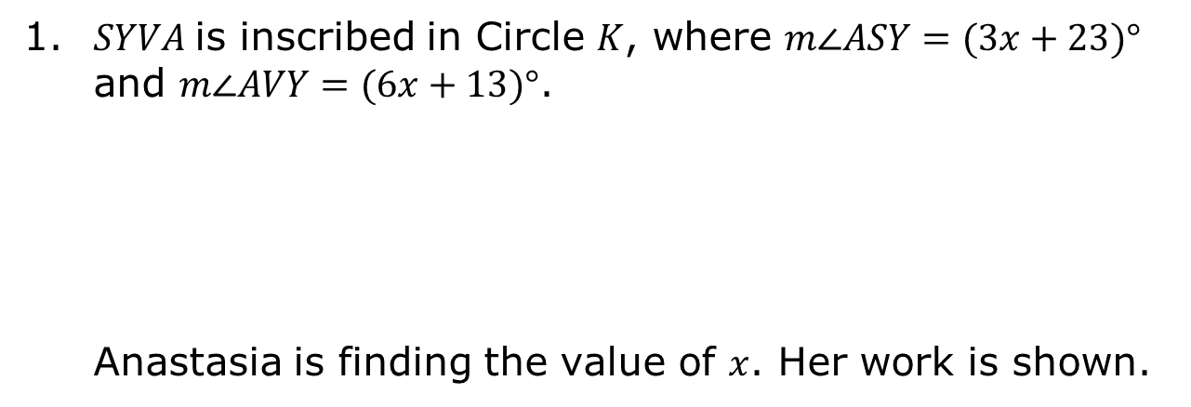
11.4.5 Wrap-Up: Error Analysis
1. $SYVA$is inscribed in Circle $K$, where $m∠ASY=(3x+23)°$ and $m∠AVY=(6x+13)°$.
Anastasia is finding the value of $x$. Her work is shown.
Anastasia’s Work
$$3x+23=6x+13$$ $$3x=10$$ $$x=\frac{10}{3}$$
volume 2, pg. 201

Slide 21
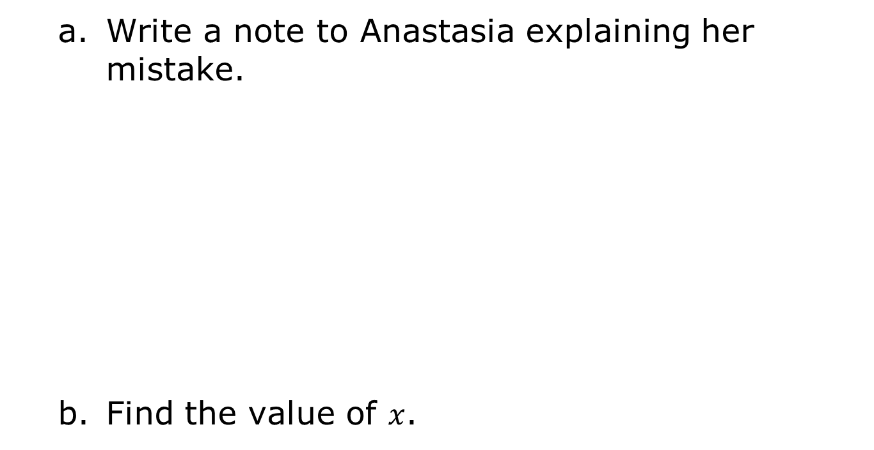
Write a note to Anastasia explaining her mistake.
Find the value of $x$.
volume 2, pg. 201

